Slide 1
The NYC Taxi CRISIS – Week Xi
Group 7
Haardik Sharma
Harsha Chandar
Madhukiran M
Yogesh Reddy

Slide 2

Problem statement
Does Uber compete with NYC yellow taxis in New York?

Slide 3
RECAP
Identify demand for NYC taxis in the absence of Uber
Calculate the demand for NYC taxis after the introduction of Uber
Is Uber competing with yellow cabs?
Calculate pickups per day from 2009-2011
Use this data to forecast demand in 2015
Forecasted value: 14,203,632
Actual:12,748,986
Calculate pickups per day from 2014-2015
Use this the number of Uber pickups as a dynamic regressor to forecast the number of NYC pickups in 2015
Calculate the difference in demand between the projected values
Is Uber a significant factor in predicting the number of NYC taxis?

Slide 4
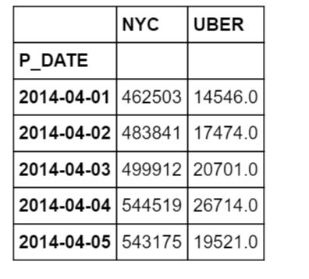
THE DATA

Slide 5
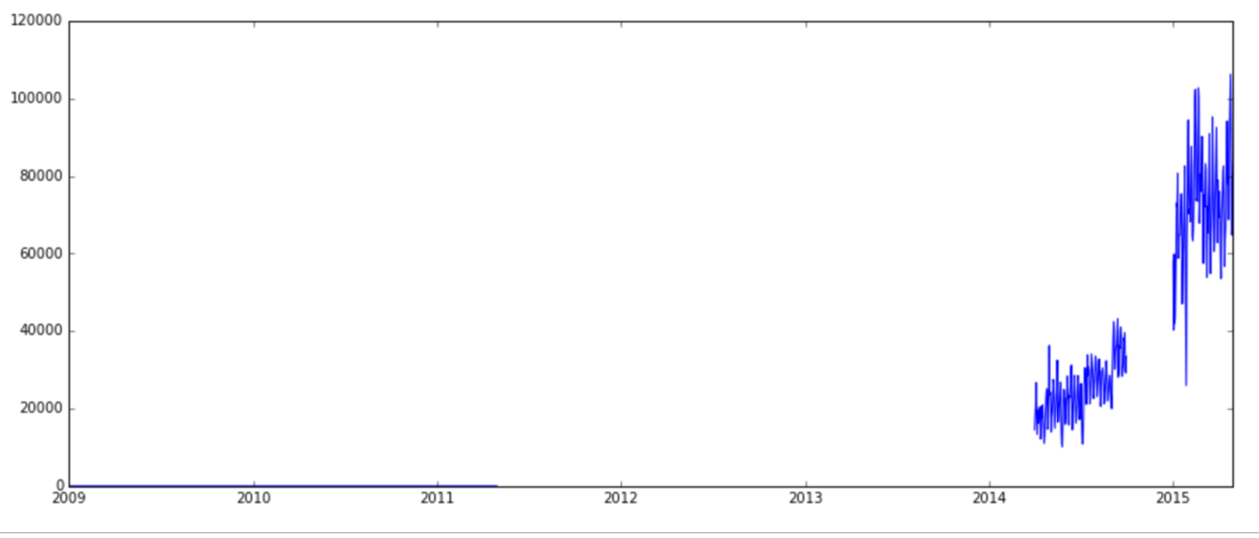
UBER PERFORMANCE

Slide 6
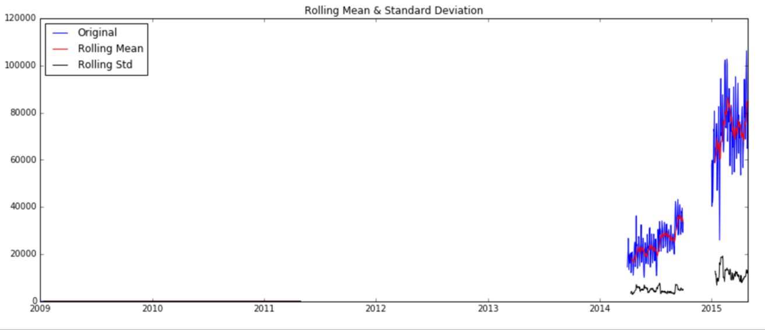
STATIONARITY TEST
Results of Dickey-Fuller Test:
Test Statistic - 0.703280
p-value 0.845898
#Lags Used 12.000000
Number of Observations Used 170.000000
Critical Value (5%) -2.878696
Critical Value (1%) -3.469413
Critical Value (10%) -2.575917
dtype: float64

Slide 7
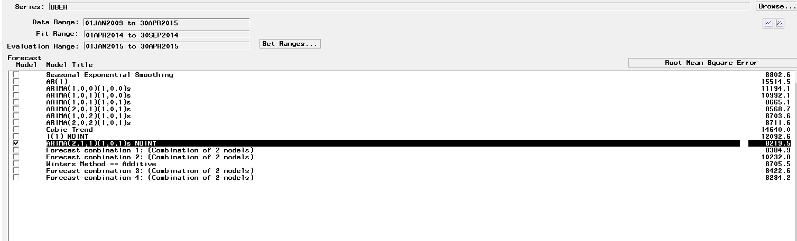
ARIMA(2,1,1)(1,0,1)s

Slide 8
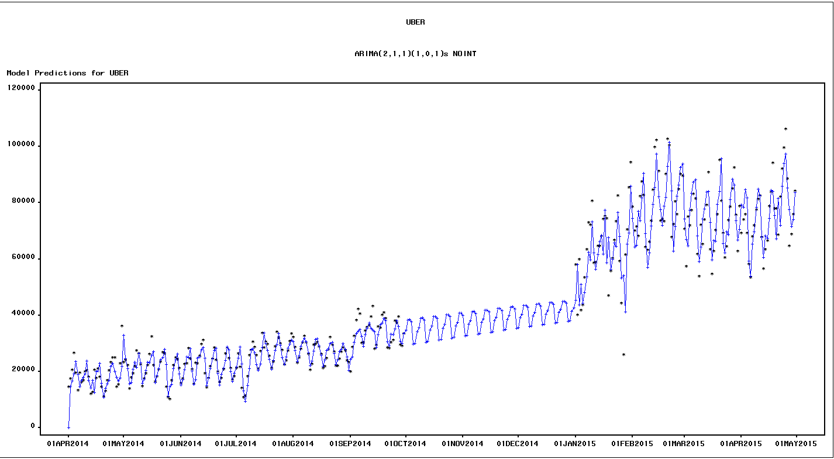
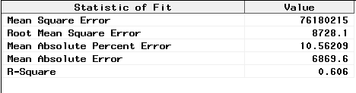
MODEL FIT

Slide 9
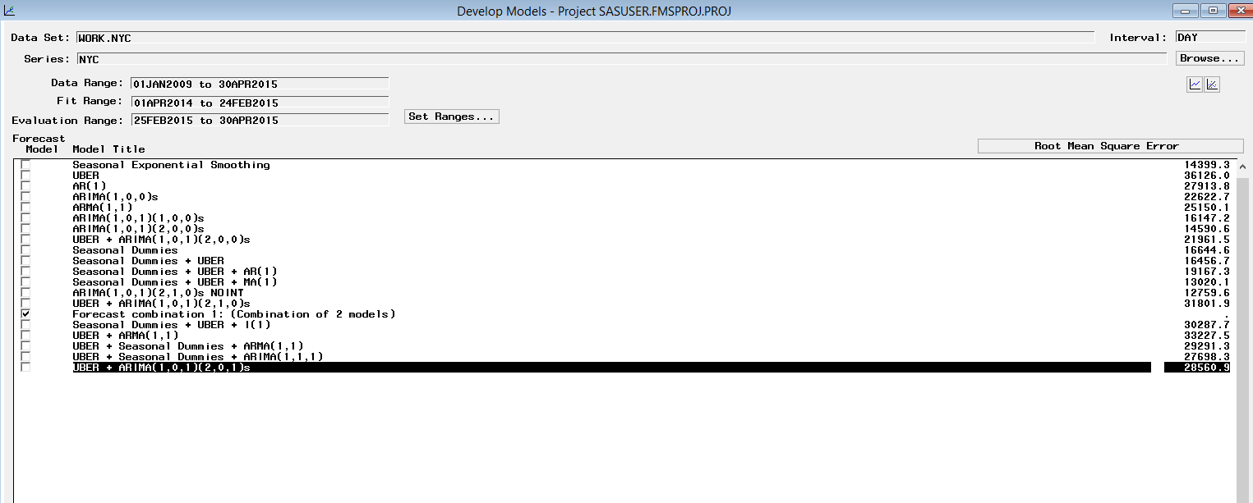
Using uber to predict nyc trips

Slide 10
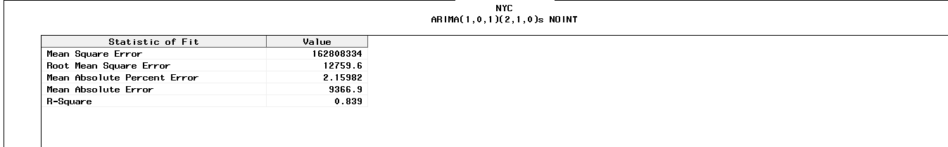
FIT STATISTICS

Slide 11
Correlation
Included the values from Jan 2009 – May 2011
Negative correlation: -0.12895

Slide 12
NEXT STEPS
Mutual Information
Will UBER overtake NYC?

Slide 13
APPENDIX

Slide 14
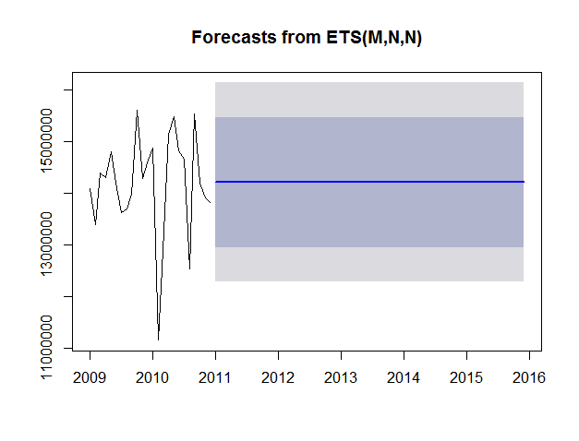
Automatic exponential smoothing

Slide 15
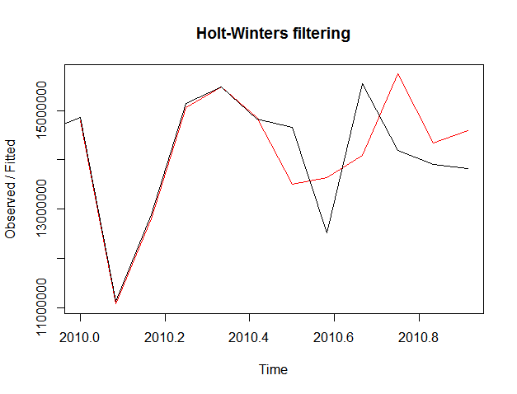
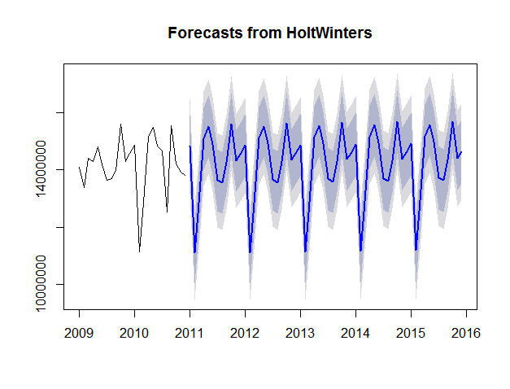
Holtwinters additive model

Slide 16
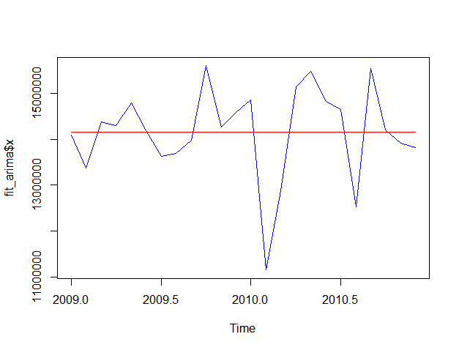
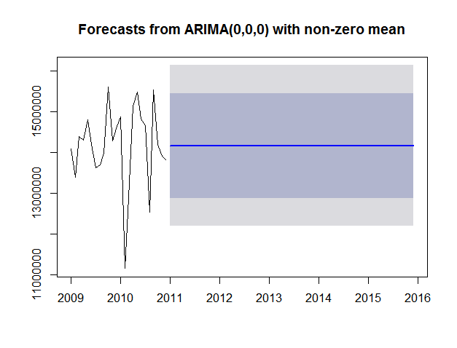
Arima – (0,0,0)

Slide 17
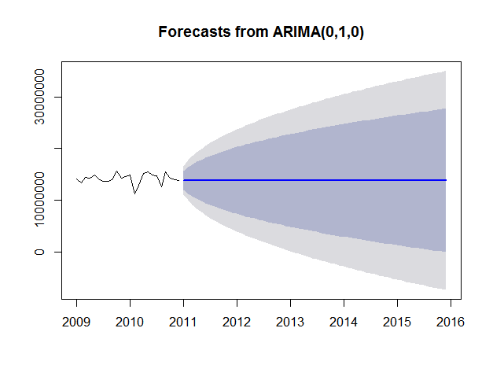
ARIMA -(1,0,0)

